Slide 1
The Pursuit of Happiness
Jeffrey Baron
DSC 530 Prof. Fadi Alsaleem

Slide 2

What is Happiness?
The Pursuit of Happiness
MRI-Simmons’ “Survey of the American Consumer”
asks this question:
I am happy with my
standard of living:
Agree Strongly
Agree Somewhat
Disagree Somewhat
Disagree Strongly
But what is the root of happiness?

Slide 3
The Contenders
The Pursuit of Happiness
Health
Correlate with “I am Satisfied with my Weight”
I make sure I take time for myself each day
Keeping a neat, organized home is a top priority
I have a better fashion sense than most people
I feel I am more environmentally conscious than most people
I often choose methods of transportation that are friendlier to the environment

Slide 4
The Contenders
The Pursuit of Happiness
Wealth
Correlate with Annual Household Income
I consider my work to be a career, not just a job
I am more capable than most peopleority
I enjoy entertaining people in my home
My friends and acquaintances look to me to organize our activities
I often find myself in a leadership position

Slide 5
The Contenders
The Pursuit of Happiness
Love
Correlate with “Spending time with my family is my top priority”
I frequently wish I had more time to spend with family
I often indulge my children with little extras
It's important to me that my children continue family cultural traditions
I enjoy maintaining traditions
I prefer a set routine in my daily life

Slide 6
The Contenders
The Pursuit of Happiness
Faith
Correlate with “Hold to Religious Belief”
Prayer is a part of my daily life
Religion should be the pillar of our society
I believe in the biblical teaching that God created the world in six days
I consider myself a spiritual person
I attend religious services regularly

Slide 7
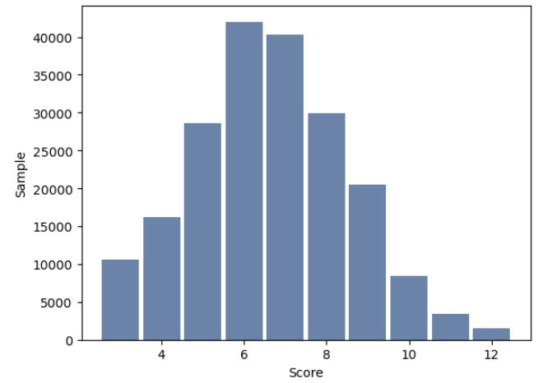
Health
The Pursuit of Happiness
The sum of the answers to the health questions produces a normal distribution, with outliers at the high end who are particularly health conscious.
key n mean mode var std cv
All Yrs 201216 6.64 6.00 3.59 1.90 0.2855
2021 23964 6.76 7.00 2.58 1.61 0.2377
2022 48668 6.61 6.00 3.58 1.89 0.2859
2023 51409 6.64 6.00 3.75 1.94 0.2914
2024 51480 6.60 6.00 3.80 1.95 0.2954

Slide 8
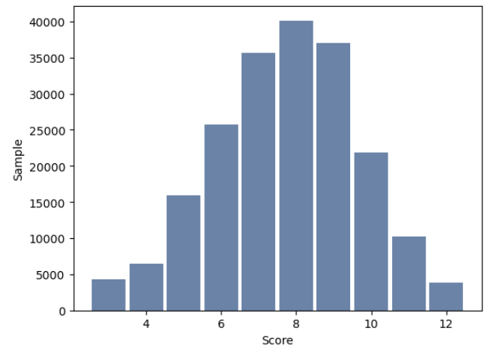
Wealth
The Pursuit of Happiness
Answers to wealth-correlated questions produce a nearly perfect normal distribution
key n mean mode var std cv
All Yrs 201216 7.72 8.00 3.77 1.94 0.2513
2021 23964 7.86 8.00 2.99 1.73 0.2201
2022 48668 7.78 8.00 3.73 1.93 0.2485
2023 51409 7.68 8.00 3.94 1.98 0.2585
2024 51480 7.64 8.00 3.85 1.96 0.2566

Slide 9
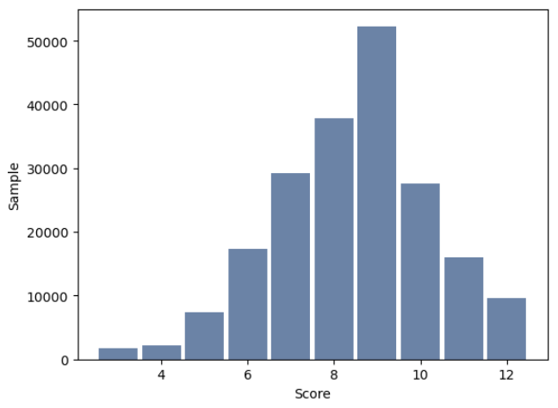
Love
The Pursuit of Happiness
The mode of love-correlated questions
is higher than the others, but there are fewer people at the high end, so the median is lower
key n mean mode var std cv
All Yrs 201216 8.45 9.00 3.30 1.82 0.2152
2021 23964 8.47 9.00 3.13 1.77 0.2089
2022 48668 8.48 9.00 3.22 1.80 0.2117
2023 51409 8.44 9.00 3.37 1.84 0.2175
2024 51480 8.42 9.00 3.34 1.83 0.2169

Slide 10
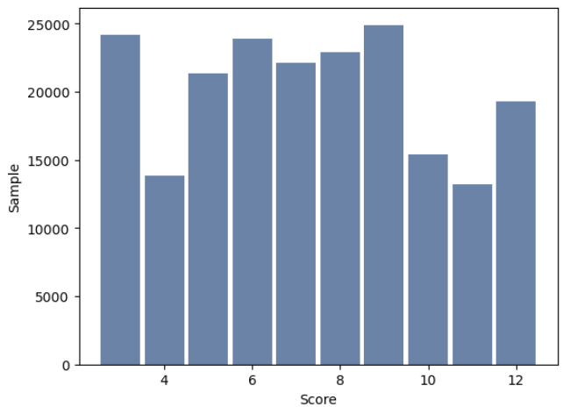
Faith
The Pursuit of Happiness
Faith-correlates are all over the map, but unlike the others, while the mean has stayed constant over the past four years, the mode has dropped from 9 to 3 during that period
key n mean mode var std cv
All Yrs 201216 7.32 9.00 7.73 2.78 0.3802
2021 23964 7.28 6.00 5.86 2.42 0.3324
2022 48668 7.29 3.00 8.15 2.85 0.3915
2023 51409 7.28 3.00 7.99 2.83 0.3883
2024 51480 7.35 3.00 7.90 2.81 0.3827

Slide 11
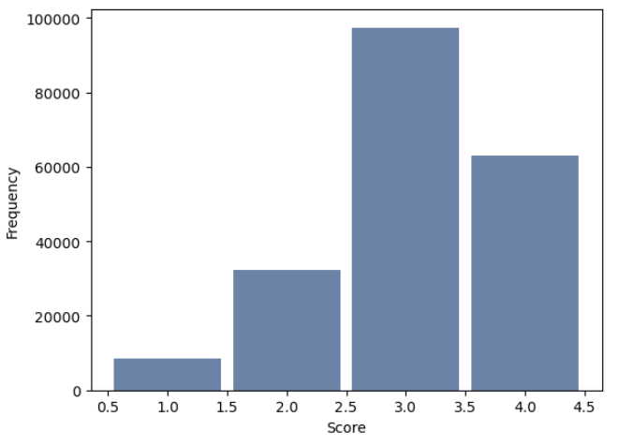
Happiness
The Pursuit of Happiness
Most people agree
that they are happy
with their standard of
living. Their scores
have been consistent
for years. But why?
What makes a person
“Happy”?
key n mean mode var std cv
All Yrs 201216 3.07 3.00 0.64 0.80 0.2609
2021 23964 3.13 3.00 0.56 0.75 0.2392
2022 48668 3.12 3.00 0.60 0.77 0.2478
2023 51409 3.06 3.00 0.66 0.81 0.2660
2024 51480 3.03 3.00 0.67 0.82 0.2704

Slide 12
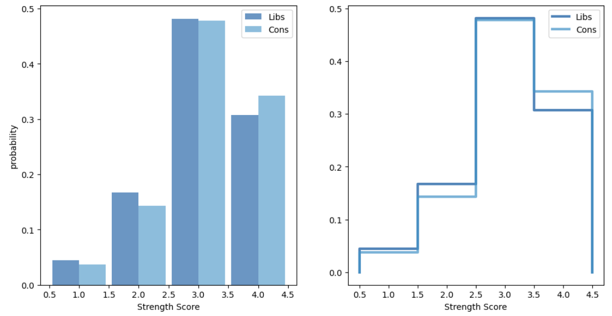
Politics?
The Pursuit of Happiness
Who is happier, Liberals or Conservatives?
Overall, conservatives have a slight advantage.

Slide 13
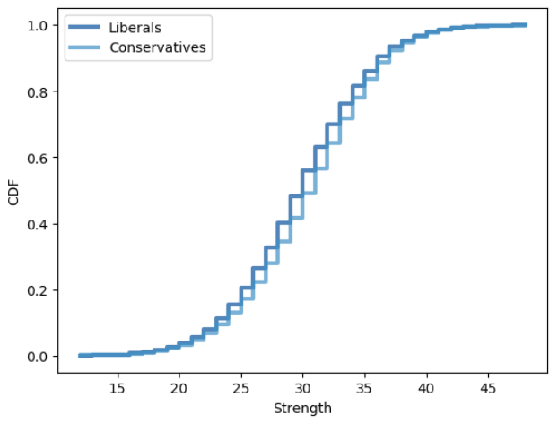
More Politics?
The Pursuit of Happiness
While conservatives tend to be happier than liberals, they tend to have lower total scores in health, wealth, love, and faith.

Slide 14
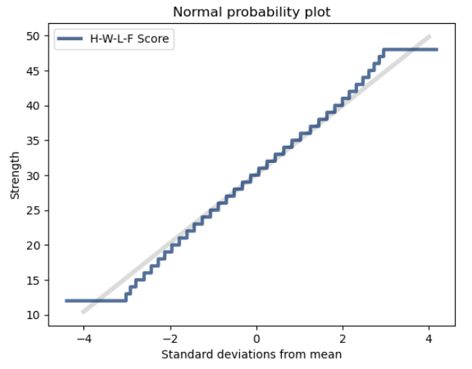
“Strength”
The Pursuit of Happiness
This shows that “strength”, being the sum of a person’s health, wealth, love, and faith scores, is an almost perfectly normal distribution, indicating that, if there was a difference between conservatives and liberals when it comes to happiness, we would’ve seen it by now.

Slide 15
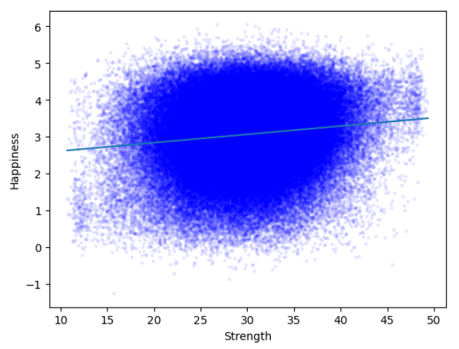
Correlation
The Pursuit of Happiness
Plotting the Strength
variable shown before
vs. happiness, it’s clear
that there isn’t much of
a correlation between
these two general
measures.
Correlation: 0.1506
Spearmans Corr: 0.1298

Slide 16
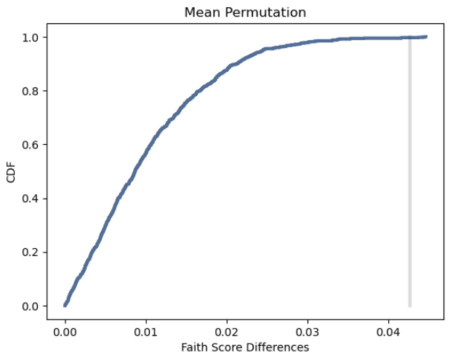
Faith Dropping?
The Pursuit of Happiness
As an aside, it’s clear (for a .002 p-value) that the mean faith score has been dropping over between 2021and 2024.

Slide 17
Overthinking It…
The Pursuit of Happiness
Looking regression analysis, it’s clear that general attitudes don’t correlate well with happiness:
Factor | Coefficient (R²)
Health | -0.016752
Wealth | 0.071035
Love | 0.016953
Faith | 0.016567
All P-Values = 0

Slide 18
Overthinking It…
The Pursuit of Happiness
In contrast, a few specific attitudinal questions correlate very well, and come closer to answering our question: What makes us happy?
Question | Coefficient (R²)
It is important to continue learning new things | 0.222244
I often do things on the spur of the moment | 0.148704
On the whole, people get what they deserve in life | 0.104581
I am an optimist | 0.090982
I enjoy entertaining people in my home | 0.082823
All P-Values = 0

